Slide 1

Field Project Netflix
Bouton nicolas Buret marcano loduynht Caravella roberto Ciuci alessandro Fina theo Nadaf aymanahamad

Slide 2
Why Netflix?
We selected Netflix for this field project for several reasons:
It’s very active on twitter (average of 14 tweets a day)
Incredibly popular with more than 14 million followers
High presence of different types of media (photo, video, animated gifs)
Original content: often humoristic and definitely never conventional
Importance of the account to raise interest and hype

Slide 3
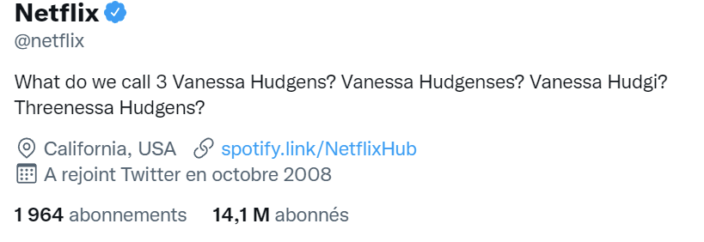
Netflix – Twitter account analysis
Netflix content is heavily focused on authenticity and interactions with people
The company replies quite often and starts conversations with its followers
For what concerns the linguistic style, Netflix adopts an informal and friendly approach
The Bio changes often and ironically adresses a content, no description of the company (would be too serious)

Slide 4
Our study of the variables
Given what was said in the previous slides, we analyzed the variables that are connected to the communication method and approach adopted by Netflix. We kept in mind that there should be consistency between the brand identity on twitter and the way the company communicates. For these reasons we have chosen to compare: 1) Media Type - Presence of Emoticons 2) Presence of Media in the Tweets – Retweets 3) Length of the Tweet - Retweets 4) Favorites – Length of the Tweet 5) Favorites – Media Type

Slide 5
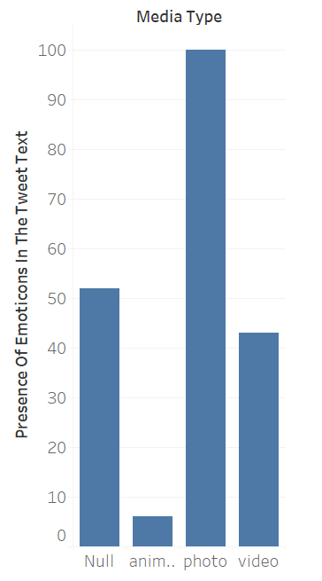
1) Media type – Presence of Emoticons
Number of tweets with different media content and presence of emojis: No media- 53
Gif- 7 Photo- 100 Videos- 41
The emoticons are used while adopting an informal tone of voice. We have seen that over-all the presence of emoticons in the tweets published by Netflix are low (201 out of 1200 tweets). Tweets with pictures have more emoticons than other media types. We also noticed the presence of combined emoticons in some tweet, but sporadically.

Slide 6
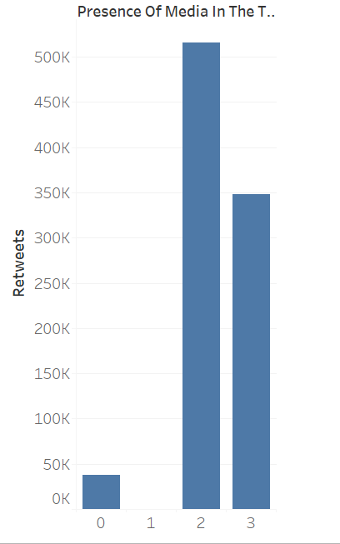
2) Presence of media in the tweets – retweets
Number of retweets for tweets with different media content : No media- 114.7
Gif- 8.94 Photo- 1037 Videos- 978
We observe that tweets with Photos (2) and Videos (3) obtain the highest number of the retweets, even considering the proportion of each media type.

Slide 7
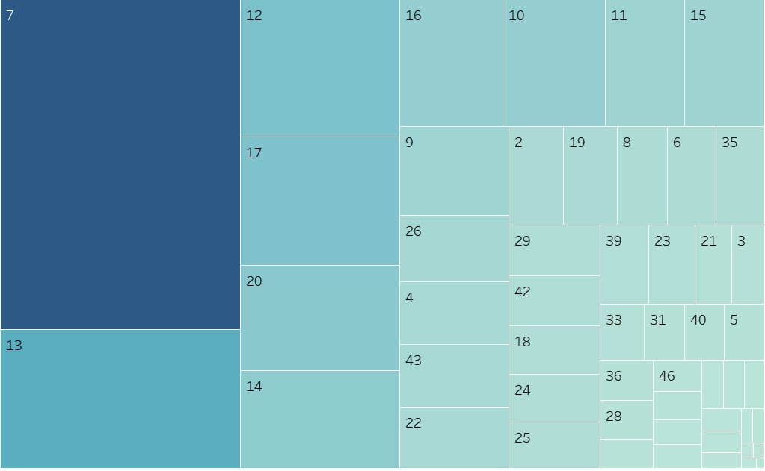
3) Length of the tweet – Retweets
This graph shows the length of the tweets in words. The biggest squares represent generally low numbers if we consider that the average length is 19.6. Tweets with lengths between 7-13 words obtain the highest number of retweets

Slide 8
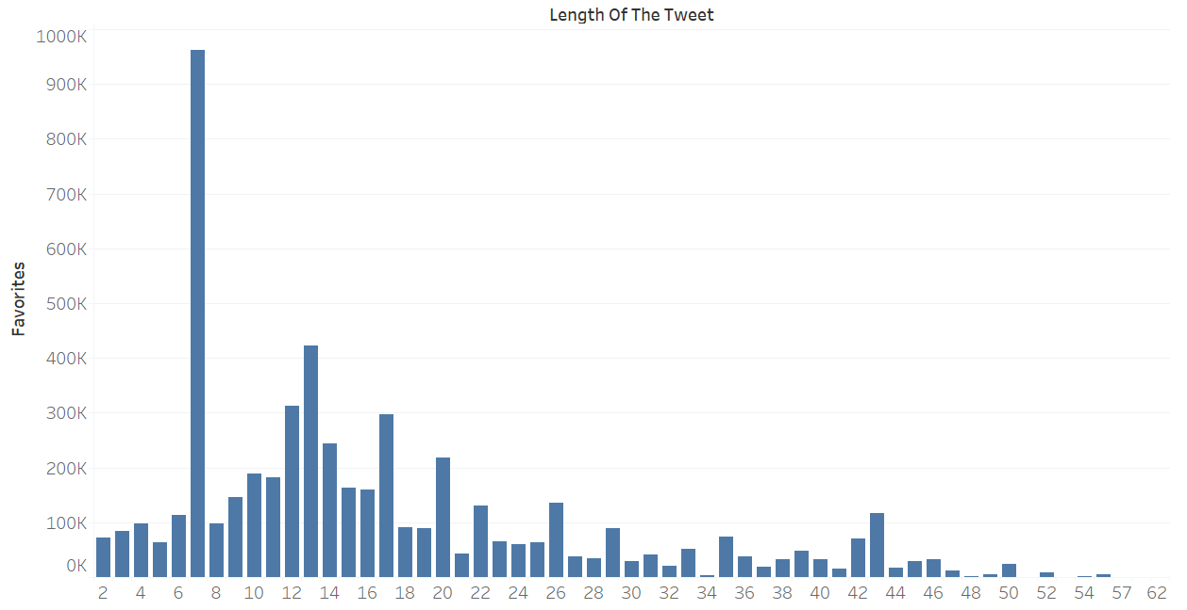
4) Favorites – Length of the tweet
Similarly, this graph shows that tweets with shorter lengths (ideally between 7-13) obtain the highest number of favorites

Slide 9
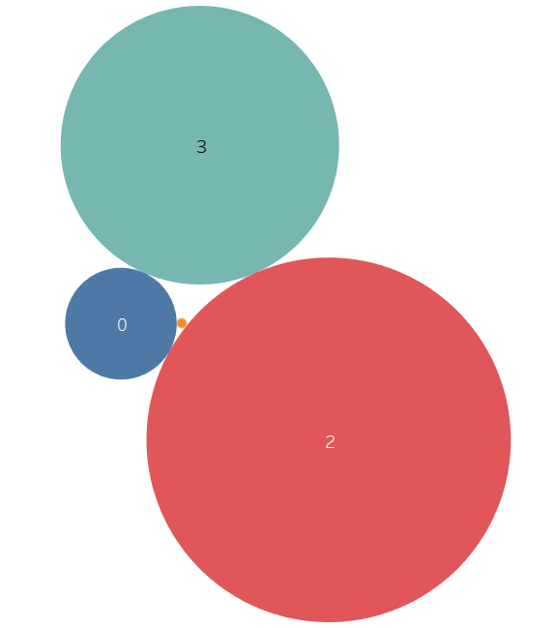
5) Favorites – media type
Number of favorites for tweets with different media content : No media- 917
Gif- 145 Photo- 6469 Videos- 5276
0=No media 1=Gif 2=Photo 3=Video The gap among the different media types for favorites is very relevant

Slide 10
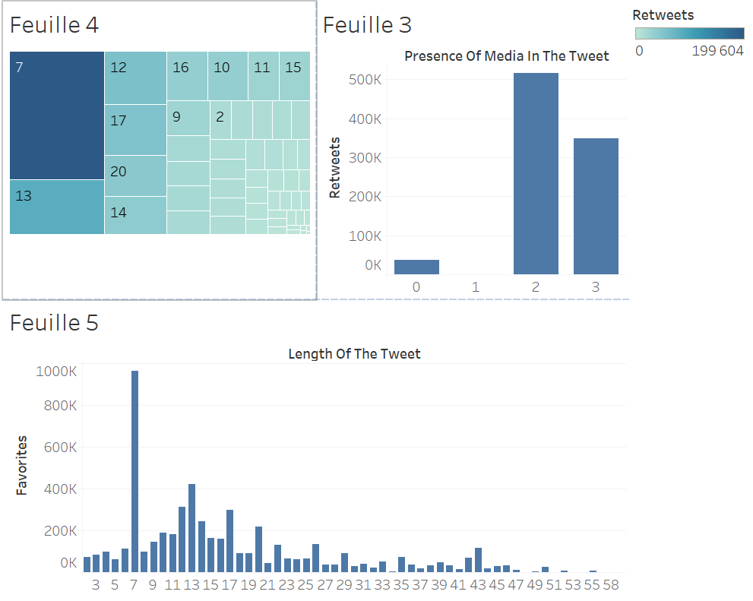
OUR FINAL DASHBOARD

Slide 11
Data insights
In our analysis we analyzed first of all Netflix's strategy, with a particular focus on emojis.
To our surprise, the overall use of emoticons was low and tweets with emoticons were mostly netflix retweets from twitter users. So, despite the informal and unconventional communication method, Netflix does not use much emoticons. In fact, looking at the data, the interaction for tweets with emojis was lower than no emoticons (5039 versus 1831 for favorites, and, 855 versus 239 for retweets)
For what concerns possible gaps and leaks in the communication strategy we analyzed favorites and retweets correlated to media type and length of the tweet (analysis from 2-5)
We have found no significant correlation among presence of question marks or exclamation marks and any interaction variable (retweets, favorites)

Slide 12
Managerial implications
According to our data analysis, Netflix should try tokeep the length of their tweets as short as possible, ideally between 7-13 words. The current average of their tweet length is 19.6 words. Interaction has been found to be significantly higher on shorter tweets.
Netflix should use photos (F- 6469, Rt- 1037) or videos (F-5276, Rt- 978) with their tweets. They should not upload gifs as the interaction was very low (F-145, Rt- 8.94). No media usage will suffice in some cases even though it has lower interaction than tweets with photos and videos(F-917, Rt- 114.7)
Although the data is inconclusive, Netflix might benefit from not using emojis in their tweets as tweets with emojis were shown to have less interaction than tweets without emojis (5039 vs 1831 for favorites, 855 vs 239 for retweets)

Slide 13
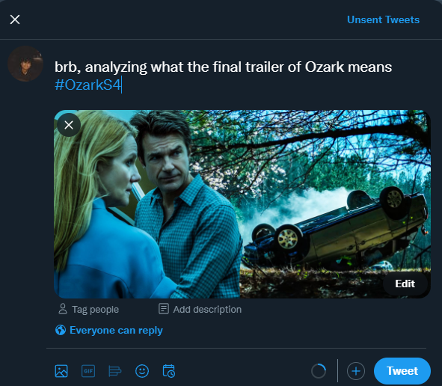
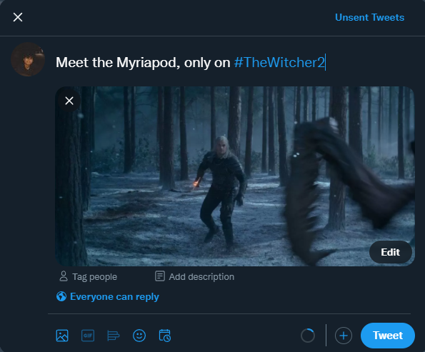
Sample tweets

